Slide 1

Website Digg Project
Soraia Felício
Analysis of Social Networks and Information
Professor: Carlos Soares

Slide 2
About the data of the Digg
Each node in the network is a user of the website, and each directed edge denotes that a user replied to another user.
Digg delivers the most interesting and talked about stories on the Internet right now.

Slide 3
Statistics and Informations of the Digg of the Konect - Koblenz network collection
Informations initial about Network
Category: communication
Nodes (users): 30,398
Edges: 87, 627
Work Informations about Network
To improve analysis about network:
Nodes (users): 15,547
Edges: 30,000
Decrease: about 50% of nodes and 66% of edges

Slide 4
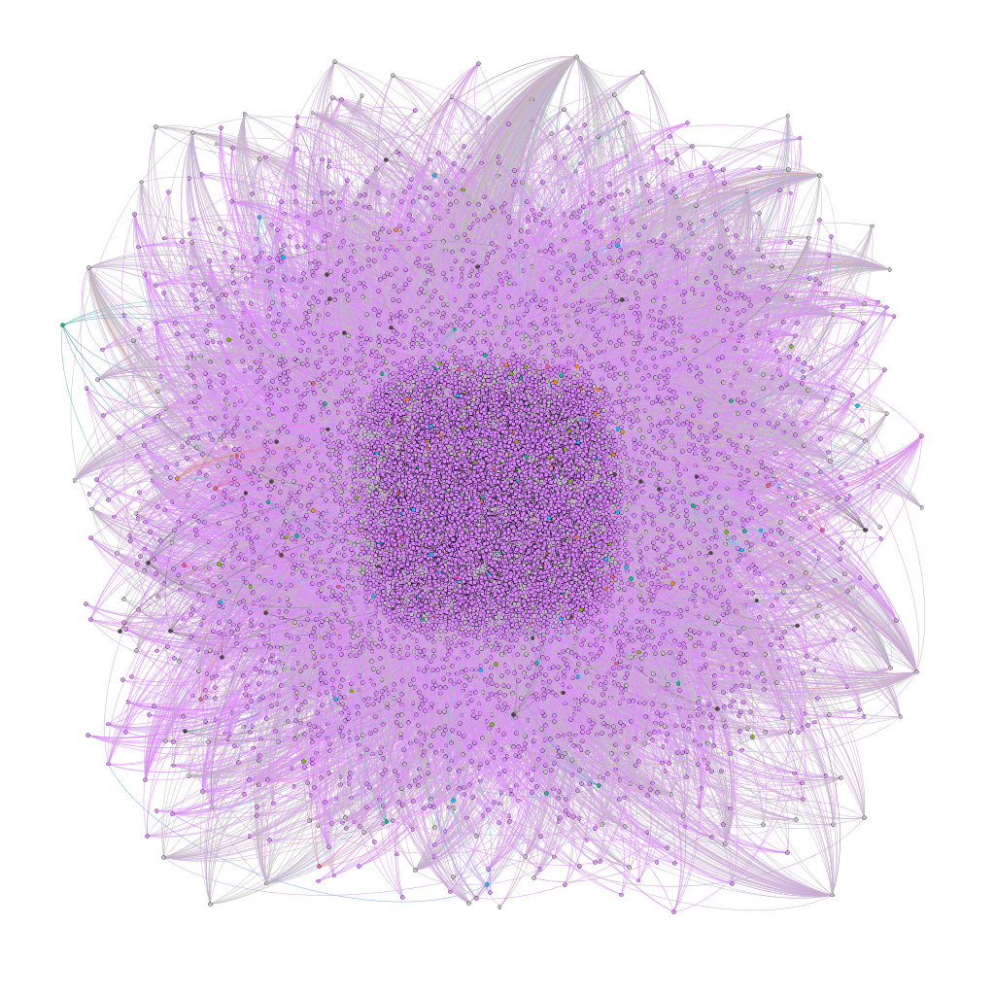
Original graph from network social Digg
Graph presentation from the initial informations (nodes and edges quantity).
Tool of analysis: Gephi
very confused and difficult to visualize and understand

Slide 5
Working with the data of the file
How import the data? It is import to right analysis.
First, attention to the readme file, which informs what is in each file and column of the file that it will be imported.
In this case, for example, open the file "README.munmun_digg_reply" in any edition tools:
Files:
meta.munmun_digg_reply => Metadata about the network
out.munmun_digg_reply => The adjacency matrix of the network in space separated
values format, with one edge per line
The meaning of the columns in out.munmun_digg_reply are:
First column: ID of from node
Second column: ID of to node
Third column: edge weight
Fourth column: timestamp of the edge

Slide 6
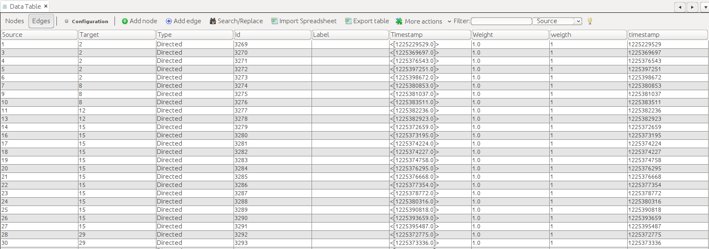
Working with the data of the file
Data Laboraty
Case necessary, open the file imported in edition tools and change the name of the columns.
The original data imported for Gephi tool:

Slide 7
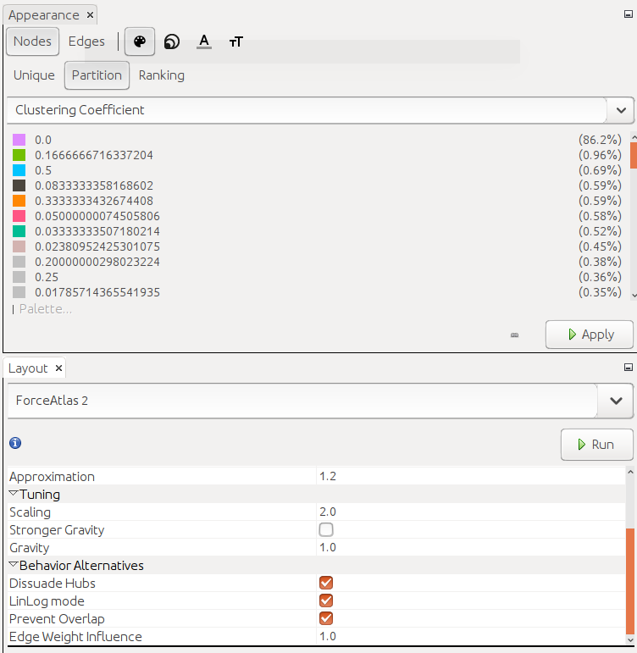
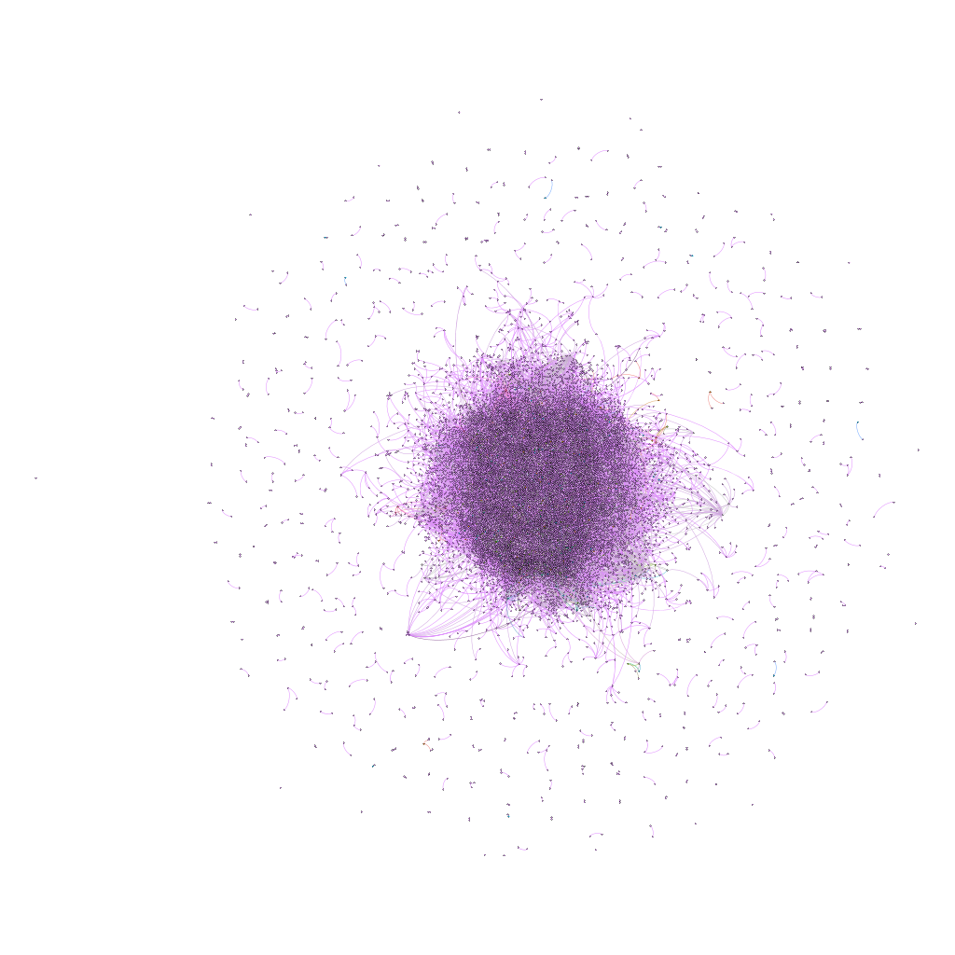
Graph considering a decrease in the scope of nodes and edges

Slide 8
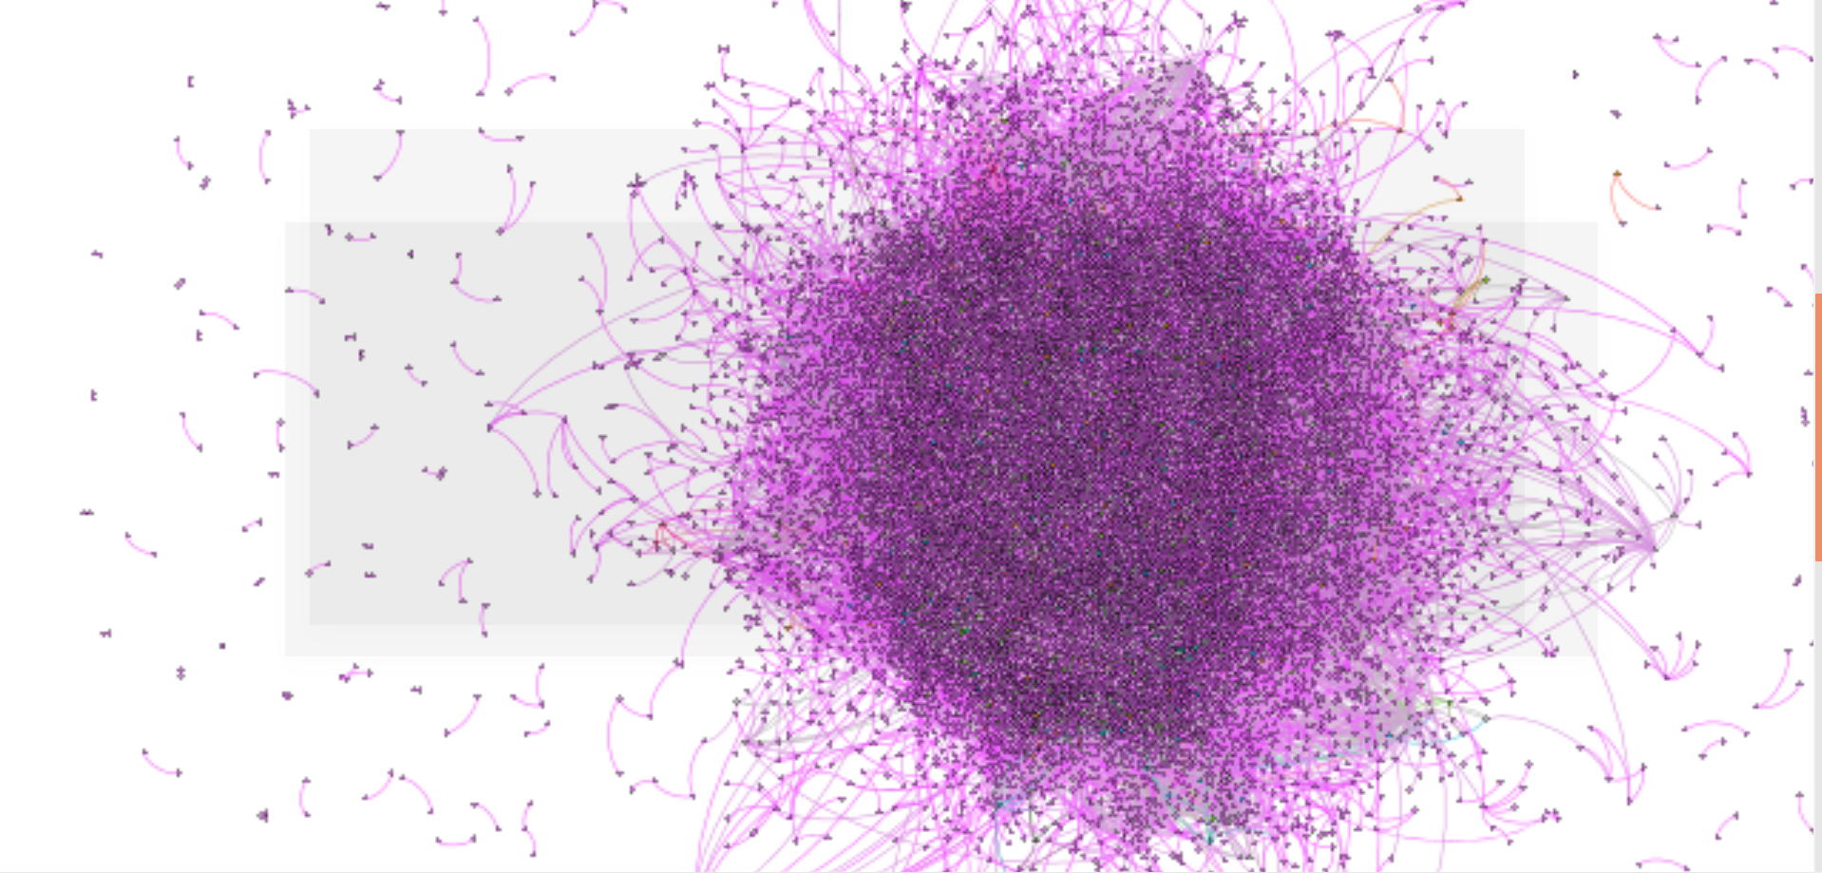
Triadic Closure considering a decrease in the scope of nodes and edges
Suppose a zoom in a piece of this graph:
See this region highlighted with red blue

Slide 9
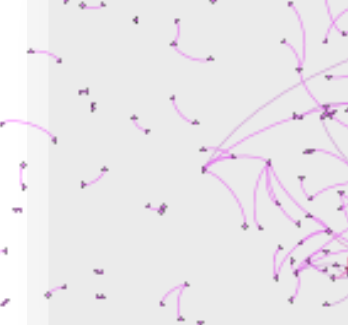
Triadic Closure considering a decrease in the scope of nodes and edges
C
what is triadic closure?
If two people in a social network have a friend in common, then there is an increased likelihood that they will become friends themselves at some point in the future.
For example: if nodes B and C have a friend A in common, then the formation of an edge between B and C produces a situation in which all three nodes A, B, and C have edges connecting each other — a structure we refer to as a triangle in the network. The term “triadic closure” comes from the fact that the B-C edge has the effect of “closing” the third side of this triangle.
Chapter 3, pg. 48.
B
A
B
C
A
B
A
C

Slide 10
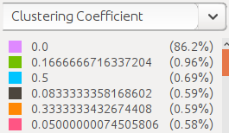
Clustering Coefficient
Analysis about clustering coefficient (Chapter 3, page 49):
86.2% none node's friends are friends with each other (is showed in the pink color);
0.96% has about 0.17 of the nodes's friend are friends with each other (is showed in the green color);
0.69% has about 0.5 of the node's friend are friends with each other (is showed in the blue color)
0.59% has about 0.08 of the node's friend are friends with each other (is showed in the black color)
this same analysis is realized with the other colors
The Clustering Coefficient of a node A is defined as the probability that two randomly selected friends of A are friends with each other.

Slide 11
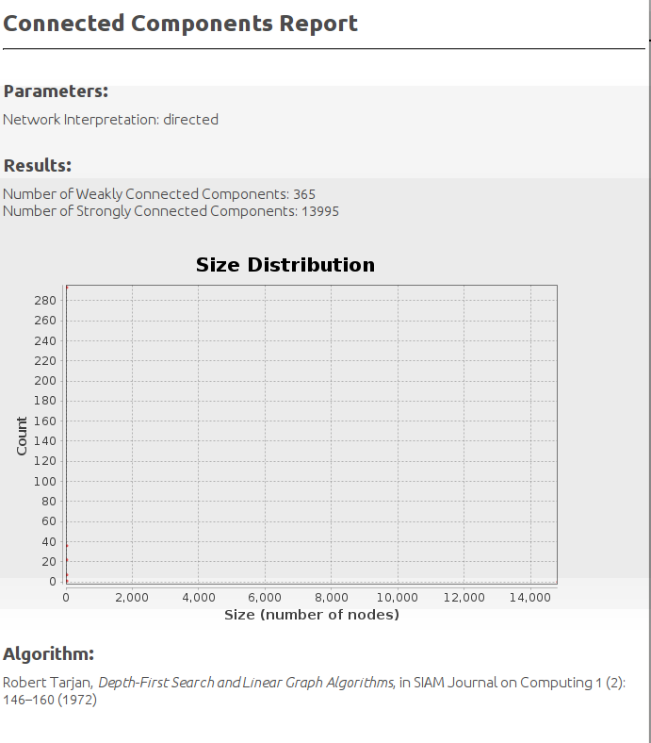
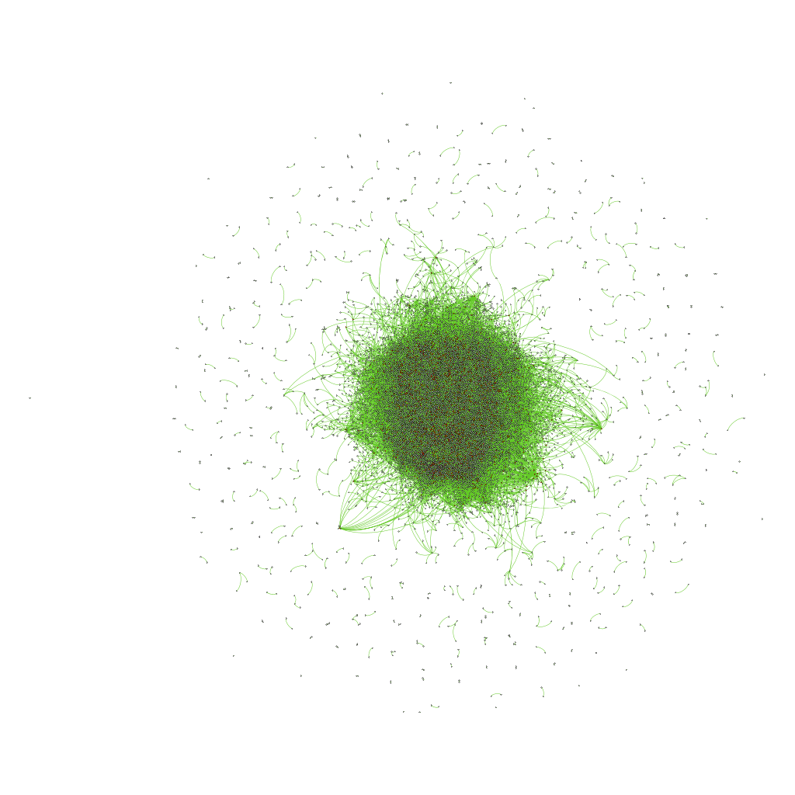
Strongly connected

Slide 12
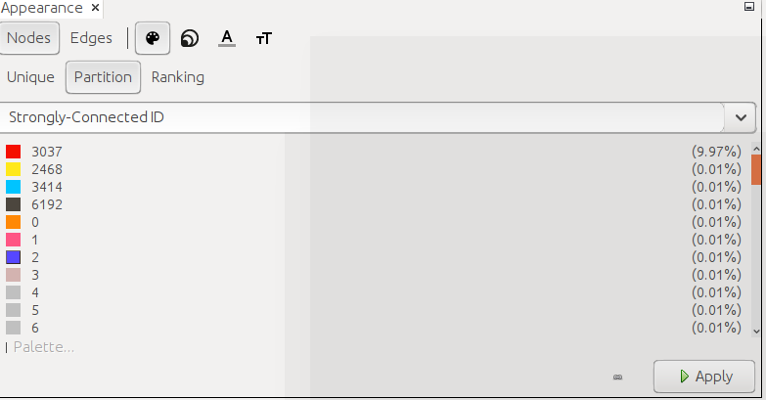
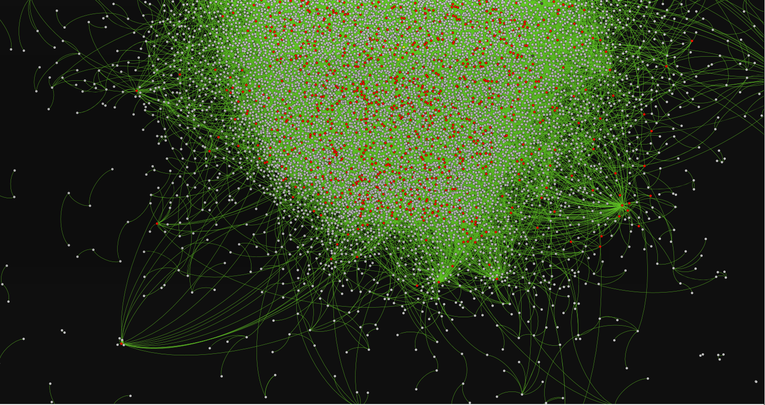
Strongly connected

Slide 13
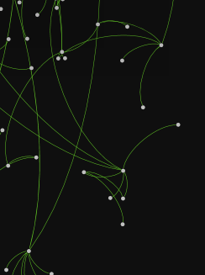
Local Bridge
E
D
B
A
c
if deleting the edge would increase the distance between A and B to a value three of A to B or vice-versa.Thus, A-B is an example of local bridge.
F
We say that an edge joining two nodes A and B in a graph is a local bridge if its endpoints A and B have no friends in common — in other words, if deleting the edge would increase the distance between A and B to a value strictly more than two.

Slide 14
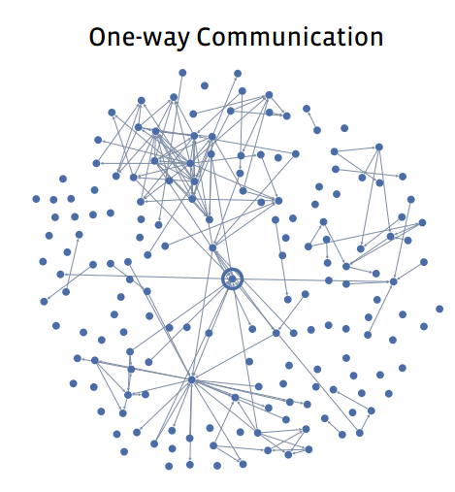
Tie Strength
Facebook
Digg
If the user sent one or more messages to the friend at the other end of the link (whether or not these messages were reciprocated). Chapter 3, page 61

Slide 15
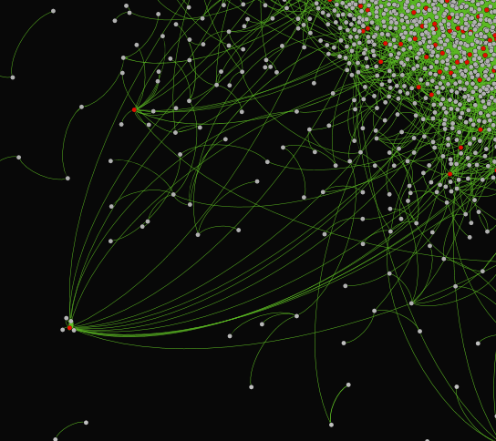
Embeddedness
What stands out about A (red node) is the way in which all of his edges have significant embeddedness.
A long line of research in sociology has argued that if two individuals are connected by an embedded edge, then this makes it easier for them to trust one another, and to have confidence in the integrity of the transactions (social, economic, or otherwise).
No similar kind of deterring threat exists for edges with zero embeddedness, since there is no one who knows both people involved in the interaction.
Chapter 3, page 66
A

Slide 16
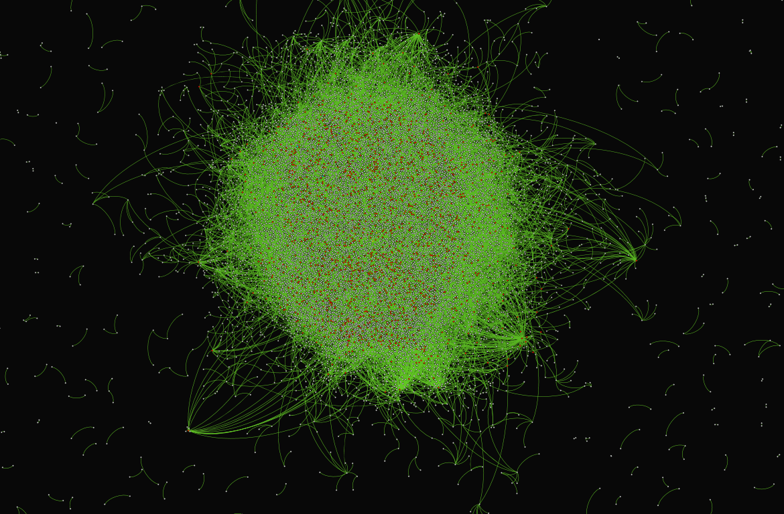
Homophily of the Digg
Homophily can produce a division of a social network into densely-connected, homogeneous parts that are weakly connected to each other.
The Digg is social network and news aggregating. The data, that we're working, are messages between users. If we consider these data suggest that by principle of homophily there are some similar between users.

Slide 17
Balance Theorem
General balancing conditions :
(i) Every two nodes in X are friends.
(ii) Every two nodes in Y are friends.
(iii) Every node in X is an enemy of every node in Y
Chapter 5, pg 124
Weakly Balanced Networks:
There is no set of three nodes such that the edges among them consist of exactly two positive edges and one negative edge.
Chapter 5, pg 130.

Slide 18
Structural Balance in Arbitrary (Non-Complete) Networks
Identifying supernodes (two steps):
To convert the graph to a reduced one in which there are only negative edges: each supernode is connected internally via positive edges, and the only edges going between two different supernodes are negative. (If there were a positive edge linking two different supernodes, we should have combined them together into a single supernode.)
To solve the problem on this reduced graph: the application procedure Breadth-First Search of the Reduced Graph (only negative edges go between supernodes (since a positive edge between two supernodes would have merged them together into a single one). As a result, our reduced graph)
Balance for General Network:
A signed graph is balanced if and only if it contains no cycle with an odd number of negative edges.
Chapter 5, pg 137
How to identify this odd number of negative edges? Identifying Supernodes.

Slide 19
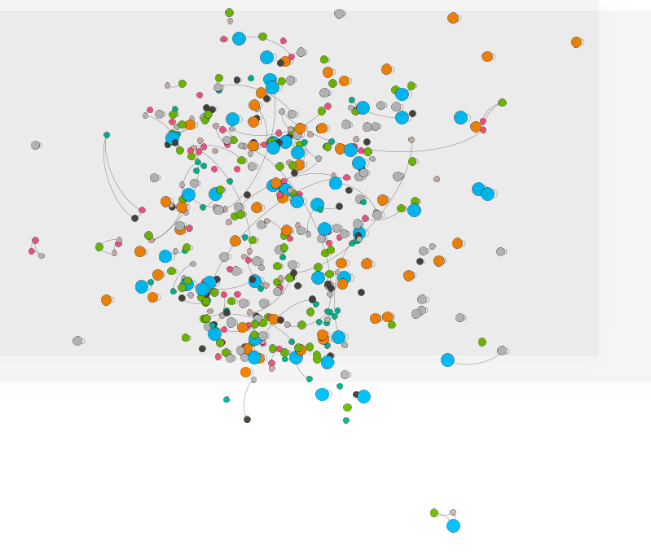
Approximately Balanced Networks
Original Balance Theorem + theorem relaxed:
Let ε be any number such that 0 ≤ ε < 1 8 , and define δ = √3 ε. If at least 1 − ε of all triangles in a labeled complete graph are balanced, then either:
(a) there is a set consisting of at least 1 − δ of the nodes in which at least 1 − δ of all pairs are friends, or else
(b) the nodes can be divided into two groups, X and Y , such that (i) at least 1 − δ of the pairs in X like each other, (ii) at least 1 − δ of the pairs in Y like each other, and (iii) at least 1−δ of the pairs with one end in X and the other end in Y are enemies.
Chapter 5, pg 144
Analysis of the Digg graph: the size of the node is how much it is connected (good node) and the filter is applied to those that have some Coefficient of Clustering (related to the pairs are friends).

Slide 20
References
Data source: http://konect.uni-koblenz.de/networks/munmun_digg_reply
Easley, D, and Kleinberg, J. Networks, Crowds, and Markets: Reasoning about a Highly Connected World. Cambridge University Press, 2010.

